Slide 1
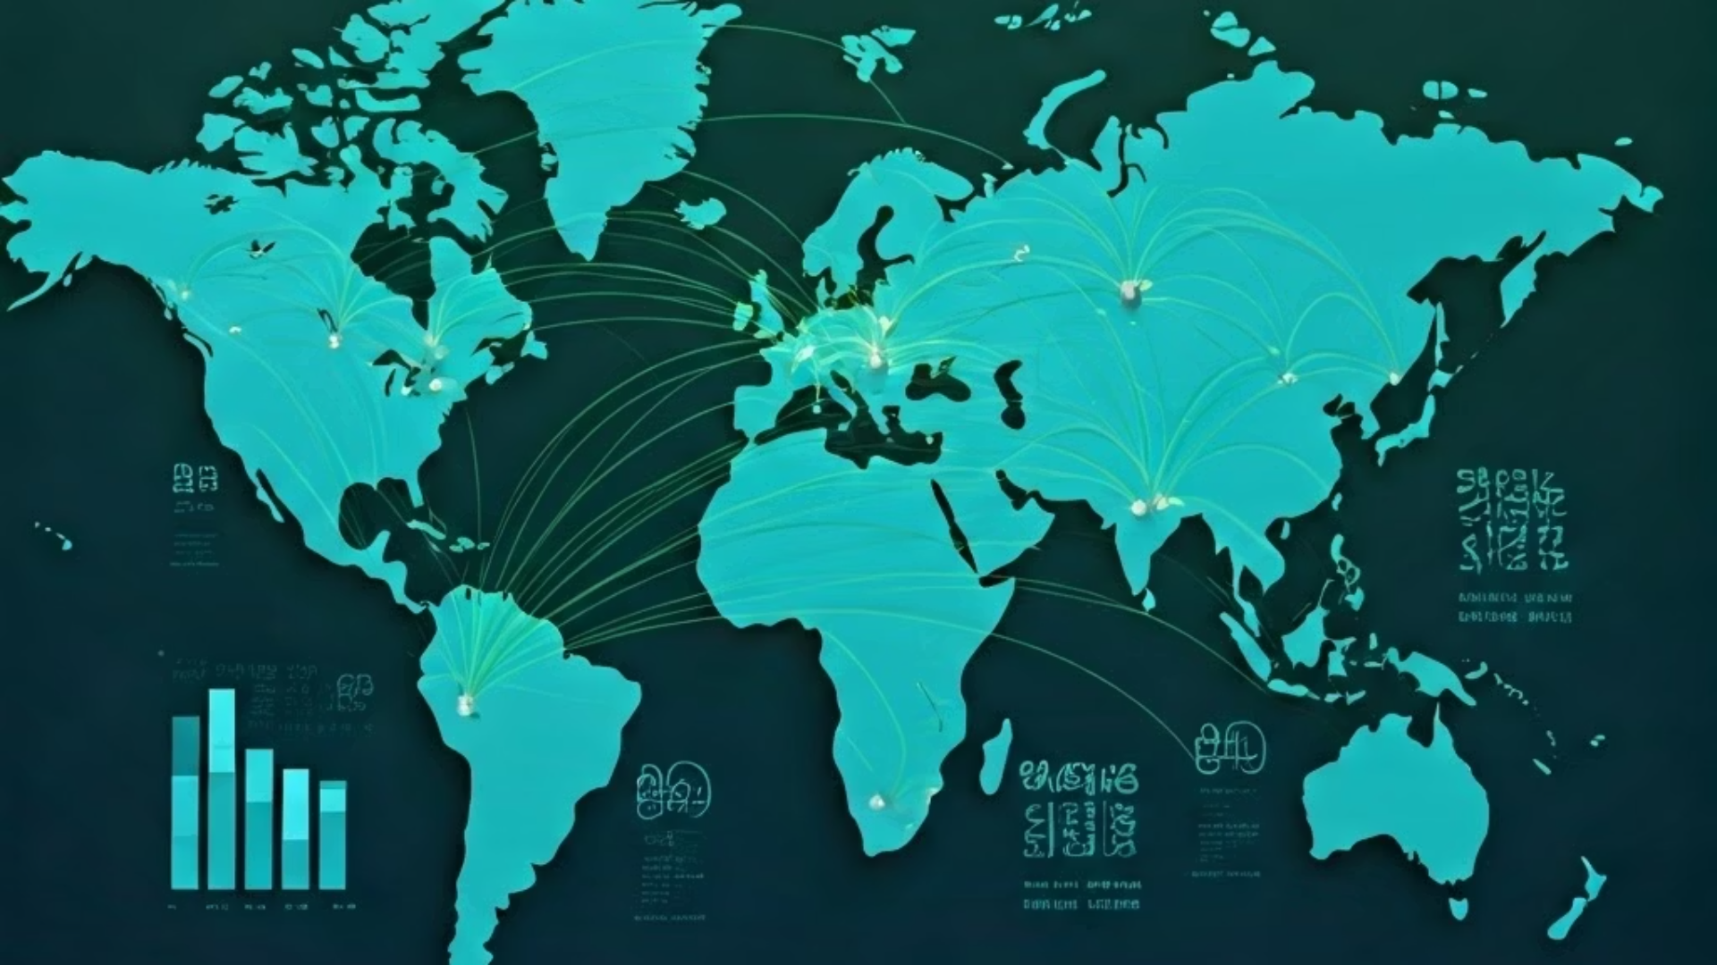
PharmaFlow: Data-Driven Supply Chain Insights
Explore PharmaFlow’s end-to-end platform for pharmaceutical shipment analytics.
Team Neptune

Slide 2

Dataset & Cleaning Process
Core Dataset
2,800+ shipments across 35 countries, multiple products and vendors.
Key Insights
Focused on delivery patterns, shipment costs, Delays
Data Cleaning
Standardized dates, numeric coercion, outlier capping, and missing value fills.
Category Handling
Missing categorical data replaced with “Unknown” to preserve rows.
Page 1

Slide 3
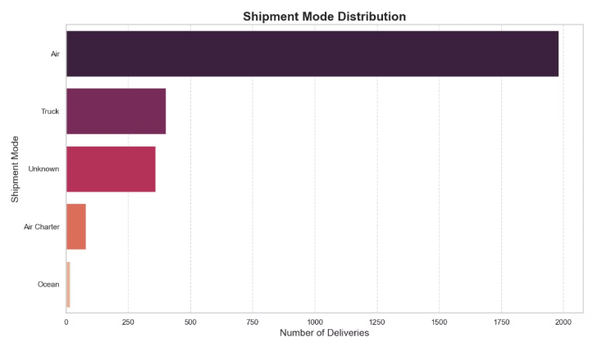
Operational Insights
Air was the most common shipment mode
Many shipments were fulfilled from RDCs (Regional Distribution Centers)
A small group of vendors handled the majority of deliveries
Monthly shipment volumes showed seasonal spikes
Page 2

Slide 4
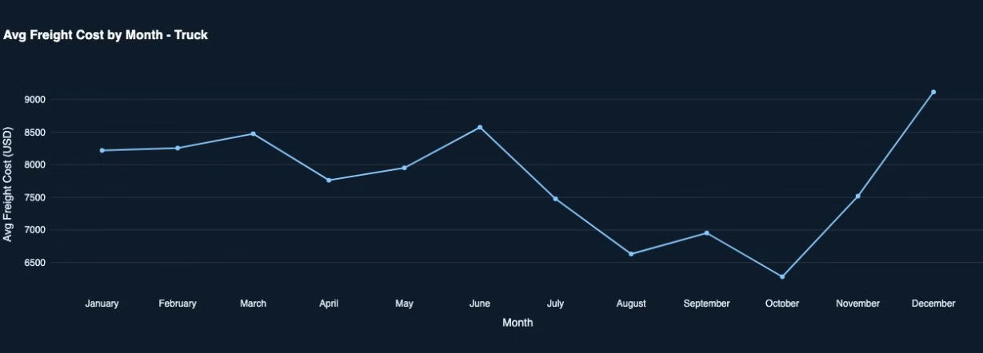
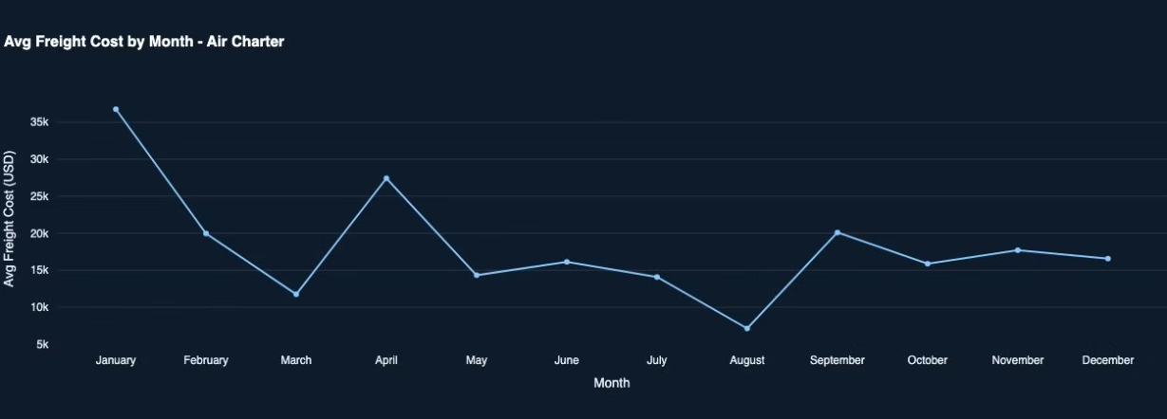
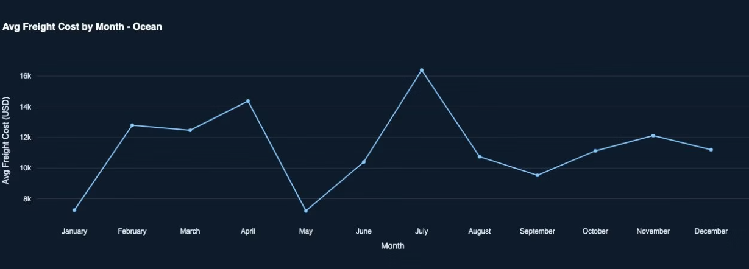
Shipment & Freight Cost Seasonal Spike
Page 3

Slide 5
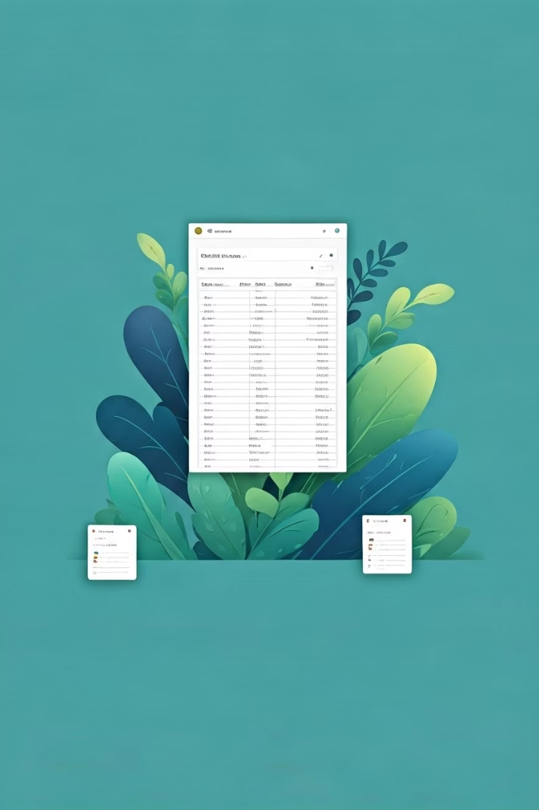
Live Data Integration
Google Sheets as Database
Data Entry Options
Streamlit connects directly to a live Google Sheet via API.
Validated web form or bulk CSV upload with success/failure feedback.
Real-Time Updates
New records appear instantly across all analytics views.
Page 4

Slide 6

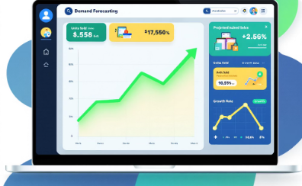

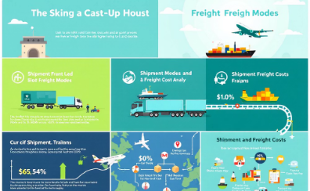
Approach
AI-Powered Chatbot
Demand Forecasting Tool
Price Prediction Tool
Shipment Mode & Freight Cost Analysis
Interactive assistance for seamless support
Accurate predictions for better planning
Optimizing pricing strategies effectively
Analyzing logistics to reduce costs
Page 5

Slide 7
AI-Powered Chatbot
Secure Credential Handling
Embedding & Retrieval
Prompt Engineering
Streamlit UI
Simple text input triggers AI analysis with instant results.
Sentence Transformer (all‑MiniLM‑L6‑v2) model encodes data chunks for fast, relevant search.
Structured JSON and schema reminders reduce hallucinations.
API keys stored safely with dotenv, never in source code.
Page 6

Slide 8





Demand Forecasting Module
Data Preparation
Monthly resampling, outlier removal, and variance stabilization.
SARIMA Modeling
Seasonal model fits annual cycles with robust back-testing.
Operational Tables
Shows top manufacturing sites, vendors, site-vendor pairs, delivery delay rate andseasonal spike
Transparency
Debug info available for power users to verify results.
Page 7

Slide 9
Price Prediction Pipeline
Data Cleaning
Time Series Setup
Forecasting
User Interface
Freight cost harmonized, numeric columns capped and filled.
SARIMAX model predicts 1-6 months with error metrics.
Dropdowns and selectors for filtering and forecast horizon.
Weekly mean prices indexed for SARIMAX modeling.
Page 8

Slide 10




Shipment Mode & Freight Cost Analysis
Data Cleaning
KPI Metrics
Missing shipment modes set to “Unknown,” freight costs zeroed if null.
Total shipments and mode percentage breakdowns displayed.
1
2
Seasonality Trends
4
3
Cost Visualization
Line charts show weekly and monthly freight cost patterns.
Horizontal bar chart compares average freight cost by mode.
Page 9

Slide 11

Streamlit Web Interface
Unified Dashboard
Service Navigation
Single-page app with branded title and service buttons.
Buttons link to chatbot, forecasting, price prediction, and more.
Custom Styling
Developer Friendly
CSS injected for consistent branding and hover effects.
Easy to extend by adding services and renderer functions.
Page 10

Slide 12
Challenges and Learnings
Data Quality: Handling inconsistencies and filling gaps was critical for accuracy.
Method Selection: Balancing trade-offs and tuning models required deep experimentation.
Scalability: Models designed to be efficient and robust on the platform.
Page 11

Slide 13
Thank You
We welcome your questions and look forward to the discussion.
Page 12

